Slide 1


Student Details
Name: INNAMURI CHITRA TEJASWINI
Skills BUILD EMAIL ID: chitratejaswini17@gmail.com
COLLEGE NAME: SRK INSTITUTE OF TECHNOLOGY
COLLEGE STATE: ANDHRA PRADESH
INTERNSHIP DOMAIN : CYBER SECURITY WITH KALI LINUX
INTERNSHIP START DATE AND END DATE : 03-06-2024 TO 12-07-2024

Slide 2
PROJECT TITLE
HIDING A TEXT INSIDE AN IMAGE USING STEGANOGRAPHY
PROBLEM STATEMENT
"An undercover officer, surrounded by criminal suspects, needs a secure and discreet way to send a critical text message to his headquarters without arousing suspicion. Due to the high risk of interception or monitoring of traditional communication channels, he requires a covert method to embed and transmit the sensitive information within a seemingly innocuous image, ensuring the message remains hidden in plain sight and reaches his superiors safely."

Slide 3
AGENDA
This agenda outlines the process of hiding a text inside an image using steganography. First, we introduce the concept of steganography and its importance. Next, we select a suitable steganography technique, that is Image steganography such as Least Significant Bit (LSB) substitution or spread-spectrum steganography. Then, we prepare the text by encrypting and compressing it, and select a suitable image to hide the text within. After that, we embed the text into the image using the chosen steganography technique. Finally, we extract and decrypt the hidden text, evaluating the performance of the steganography system along the way.

Slide 4
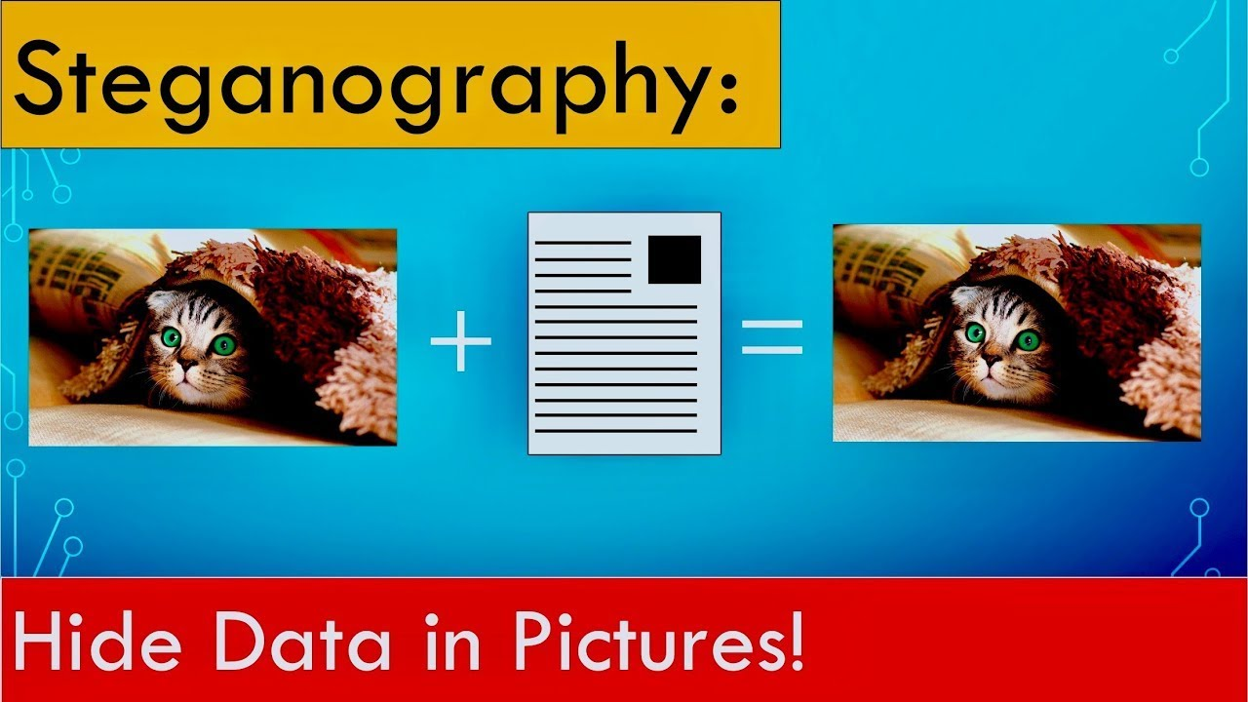
PROJECT OVERVIEW
This project develops a steganography tool that Hides text messages within images using the RGB color model.
Steganography is the art of hiding secret information within a
non-secret message, image, or other medium in such a way that the
very existence of the secret information is not apparent.
Types of Steganography: Image Steganography, Text Steganography,
Audio Steganography, Video Steganography,
Now in this I used Image Steganography. The process starts by selecting a carrier image and encoding the text message into a binary format. Then, the red, green, and blue (RGB) pixel values of the image are modified to embed the encoded message. Specifically, the least significant bits of the RGB values are replaced with the message bits, ensuring imperceptible changes to the image. The modified image, seemingly unchanged, can be stored or transmitted. To extract the hidden message, the RGB values are analyzed to retrieve the embedded bits, which are then decoded to reveal the original text. This RGB-based steganography technique offers a secure way to hide data in images, suitable for applications requiring discreet communication.

Slide 5
WHO ARE THE END USERS of this project?
The end users of this image steganography project could be individuals or organizations who want to hide sensitive information or messages within images.
This technology may appeal to security professionals, intelligence agencies, military personnel, researchers, and individuals concerned about data privacy, organizations requiring secure communication channels.
Undercover agents or law enforcement officers
Corporate security teams or executive management
Whistleblowers or investigative journalists
Activists or dissidents in sensitive or dangerous situations
Privacy-conscious individuals (e.g., political dissidents, celebrities)
Security researchers or penetration testers
Government agencies (e.g., CIA, NSA, FBI)
Special forces or special operations teams
Anyone requiring covert communication or data hiding.

Slide 6
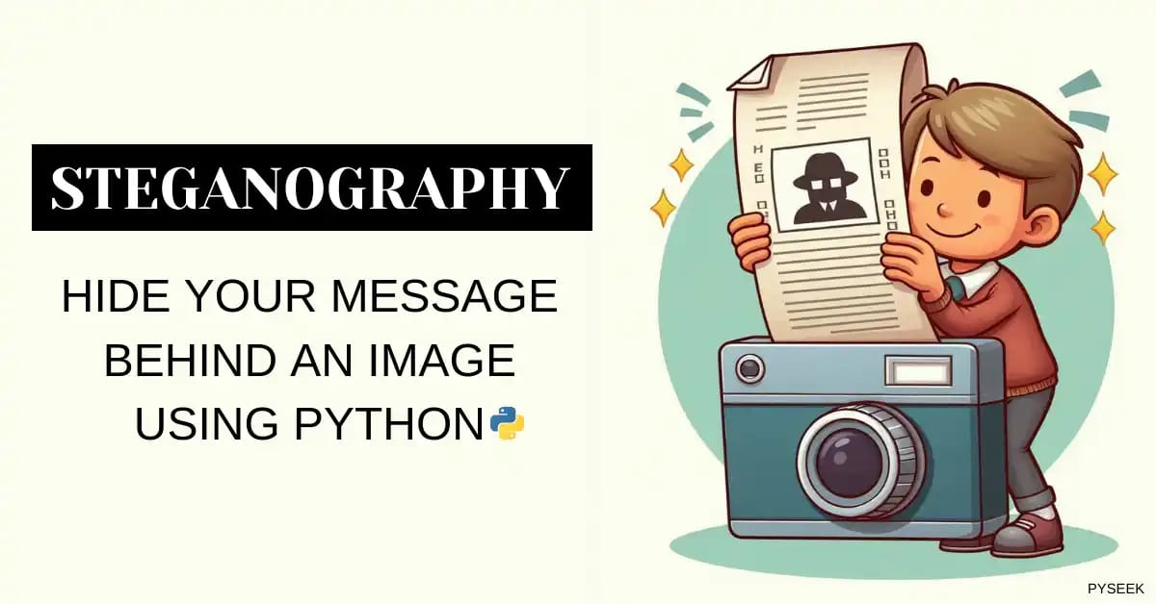
YOUR SOLUTION AND ITS VALUE PROPOSITION
The solution is the Image Steganography using RGB Pixel Manipulation. That is like the hide a text inside an image using steganography, first encrypt and compress the text using AES encryption and Huffman coding respectively. Then, select a suitable cover image and resize it to ensure it's large enough to hide the text. Next, use the LSB substitution technique to hide the text in the image by replacing the least significant bits of each pixel with the bits of the encrypted and compressed text. Create a new image with the hidden text (stego-image) and send it over an insecure channel. To extract the hidden text, receive the stego-image, extract the text using LSB substitution, and decrypt and decompress it using AES and Huffman coding respectively. This can be implemented using Python with libraries like Pillow and PyCrypto, and can be used for covert communication, but has limitations like limited text capacity and requires careful selection of cover image and steganography technique to avoid detection.

Slide 7
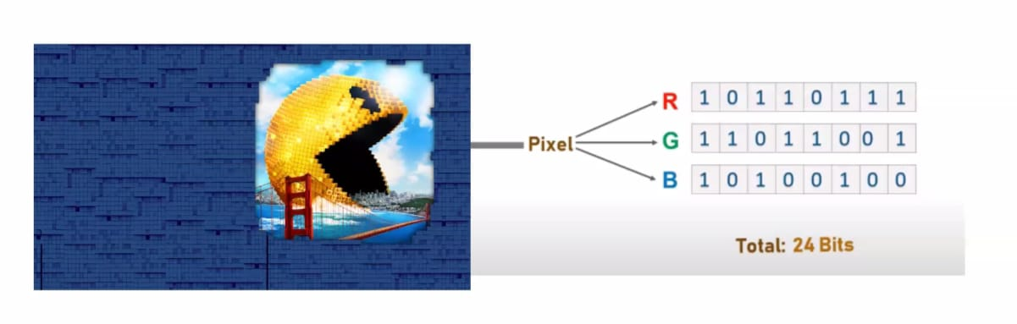
How did you customize the project and make it your own
Simplifying the encoding process using RGB pixel manipulation.
Emphasizing the importance of security and covert communication.
Highlighting the value proposition and benefits of using image steganography.
Adapting the language to fit the context of an undercover officer's needs.
Ensuring the solution is easy to understand and implement.
Advanced Encryption: Integrate a more secure encryption algorithm, like AES, to encrypt the text before hiding it in the image.

Slide 8
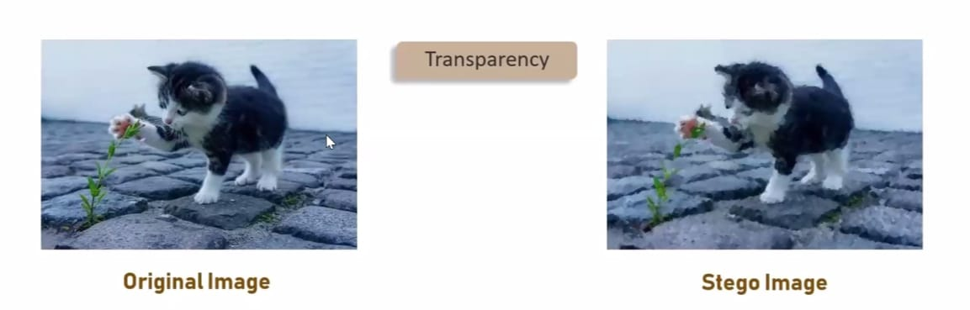
MODELLING
Imports the necessary libraries: cv2 (OpenCV), string, and os.
Defines two dictionaries, p and q, which map characters to their ASCII values and vice versa.
Reads an image file ("flower.jfif") using cv2.imread() and stores it in the variable x.
Gets the shape (height, width, channels) of the image and prints it.
Asks the user to enter a security key and a secret message (text to hide).
Encodes the secret message into the image by XORing each character's ASCII value with the corresponding pixel value in the image. It uses the security key to determine which pixels to modify.
Saves the modified image as "encryptimage.jpg" and opens it using the default image viewer.
Asks the user to enter a choice (0 to extract data from the image).
If the user chooses to extract data, it prompts them to re-enter the security key.
If the re-entered key matches the original key, it extracts the hidden text by XORing the pixel values with the key and prints the decrypted text.
If the keys don't match, it prints an error message.

Slide 9


Results
Original Image
Encrypted image
Successfully, hiding a text inside an image using steganography with RGB method

Slide 10
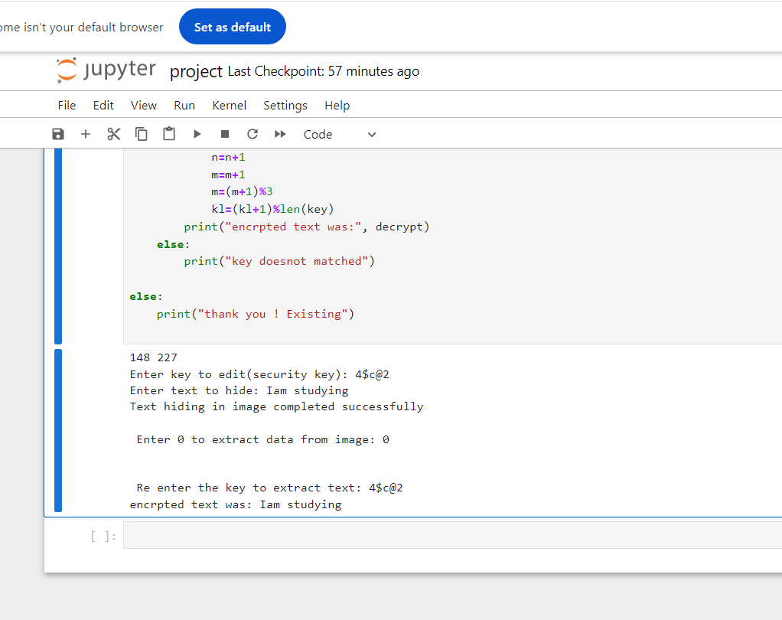
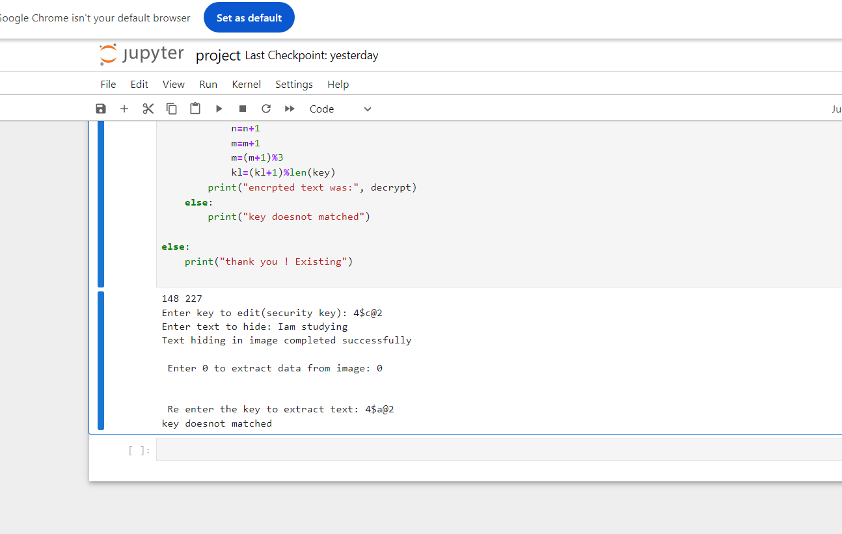
OUTPUT FOR STEGANOGRAPHY CODE
Giving Correct Security Key
Giving Wrong Security Key

Slide 11
links
https://github.com/chitratejaswini/Image-Steganography.git

